Slide 1
KMOU Division of Marine Engineering
Introduction to Pandas

Slide 2
Introduction to part-time lecturer (Minho Park)
EDUCATION
2014: B.A., Marine system engineering, National Korea Maritime and Ocean University, Busan
2023: M.S., Marine engineering, National Korea Maritime and Ocean University, Busan
2025: Ph.D., Marine engineering, National Korea Maritime and Ocean University, Busan
POSITIONS
2012: Marine engineer (Final position: Apprentice engineer), Hanjin Shipping
2014-2018: Marine engineer (Final position: 2nd engineer officer), H-Line Shipping
2019-2020: Marine engineer (Final position: 1st engineer officer), G-marine service
2021-2025: Researcher, National Korea Maritime and Ocean University
2025-date: Postdoctoral Fellow (BK21 Four), National Korea Maritime and Ocean University

Slide 3
Why Pandas library?
Current era: 4th Industrial Revolution
What is major leading items in 4th Industrial Revolution?
1) Artificial Intelligence (AI)
2) Big Data & Advanced Analytics
3) Robotics & e.t.c.
What ability is important in 4th Industrial Revolution?
1) Coding skill
2) Understanding of AI and various libraries

Slide 4

Why Pandas library?
What is important to improve coding skill?
1) Understanding of Python
2) Understanding of various Python libraries
3) Practices & Problem-solving skills (especially in solving encountered errors during coding).
What is Python?
1) It was developed in 1991 by Guido van Rossum (nationality: Netherland).
2) Python is a high-level, interpreted programming language that is widely used in software development, data science, automation, artificial intelligence, and web applications.

Slide 5

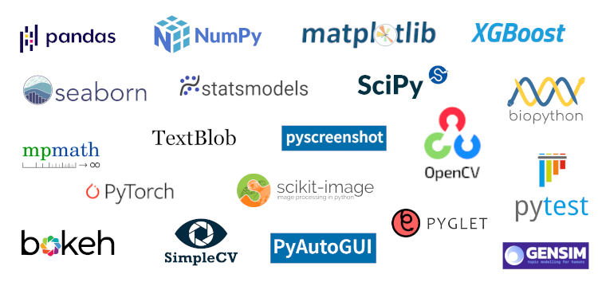
Why Pandas library?
What is Python libraries?
1) It is not the library that we know.
2) Rather it is likely the software tool to help realizing what developer wants to achieve.
3) In Python, a library for AI is a collection of pre-written code, tools, and functions that helps developers build artificial intelligence (AI) applications more easily. Instead of writing everything from scratch (like neural networks, math functions, or optimization algorithms), developers use AI libraries to save time and focus on solving real problems.
Examples of Python Libraries

Slide 6



Why Pandas library?
What is the Pandas library?
1) It is the best library to handle big data.
2) Pandas is an open-source Python library used for data manipulation and analysis. The name comes from “Panel Data” (econometrics term) and it is one of the most important libraries in data science, machine learning, finance, and statistics.
3) Developer Wes McKinney started working on Pandas in 2008 while at AQR Capital Management out of the need for a high performance, flexible tool to perform quantitative analysis on financial data. Before leaving AQR, he was able to convince management to allow him to open source the library.

Slide 7
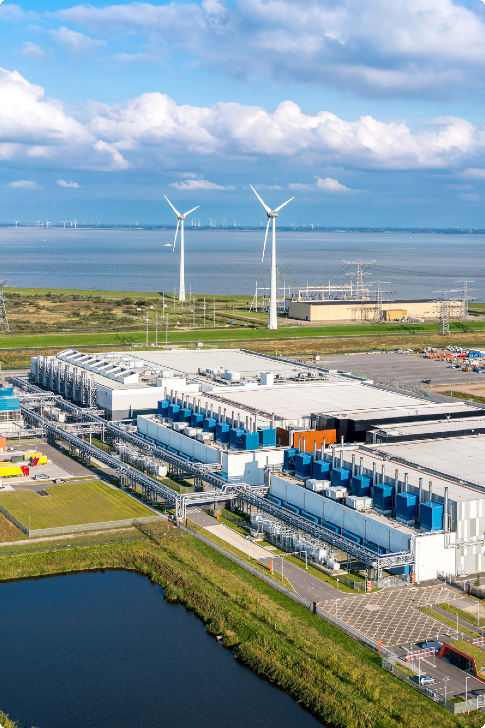
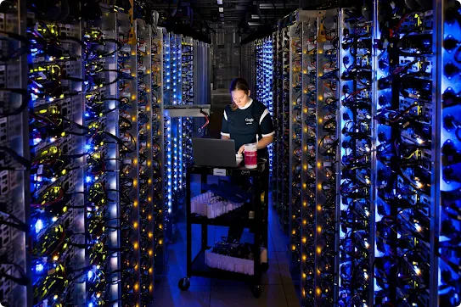
Why Pandas library?
What is big data?
1) Literally, it means big data.
2) Everywhere big data is collected to data center. One of the representative data that is collecting everyday is data from mobile phone and computer. (Youtube, Kakaotalk, Instagram, google, and so more.)
3) Those collected data is analyzed and feed to AI model. The Youtube recommendation algorithm is working based on this process. Everything we click and how much we watched is stored as big data. That’s why we are difficult to get out of Youtube and then Youtube earn lots of money by advertisement. It is all about money.
Google Data Centers

Slide 8
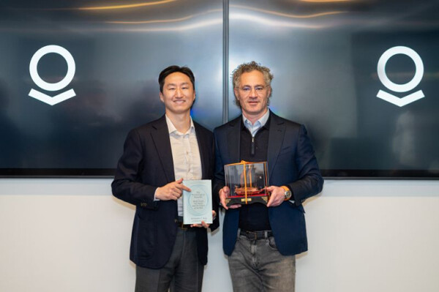
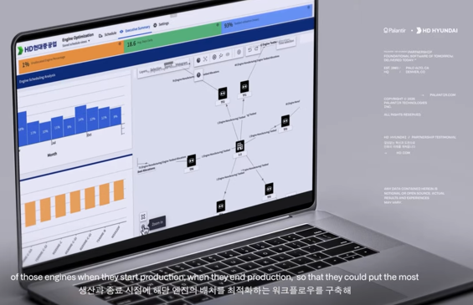
Why Pandas library?
Why Pandas library?
1) Something we can imagine that Google (Youtube) collected excel file with 100,000,000 rows and 5 columns with information of worldwide subscirbers (age, location, what video they watched, How long they watched, category of video).
2) However, the Microsoft Excel limits row and column to 1,048,576 and 16,384, respectively. Then, how to handle that kind of big data?
3) That’s why the Pandas is needed and exists. Much more is that Pandas handle big data with extremely faster speed than Microsoft Excel, which even cannot handle big data.
4) Shipbuilding and shipping area also actively collecting big data to improve their solution.
HD Hyundai collaborates with Palantir

Slide 9

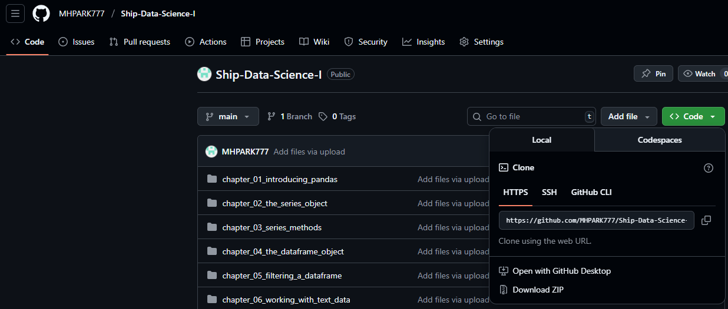
Main textbook for class
“Pandas in Actioin” (34,200 KRW)
Web page for downloading code of modified “Pandas in Actioin”:
https://github.com/MHPARK777/Ship-Data-Science-I
Click “Code” and “Download ZIP”

Slide 10

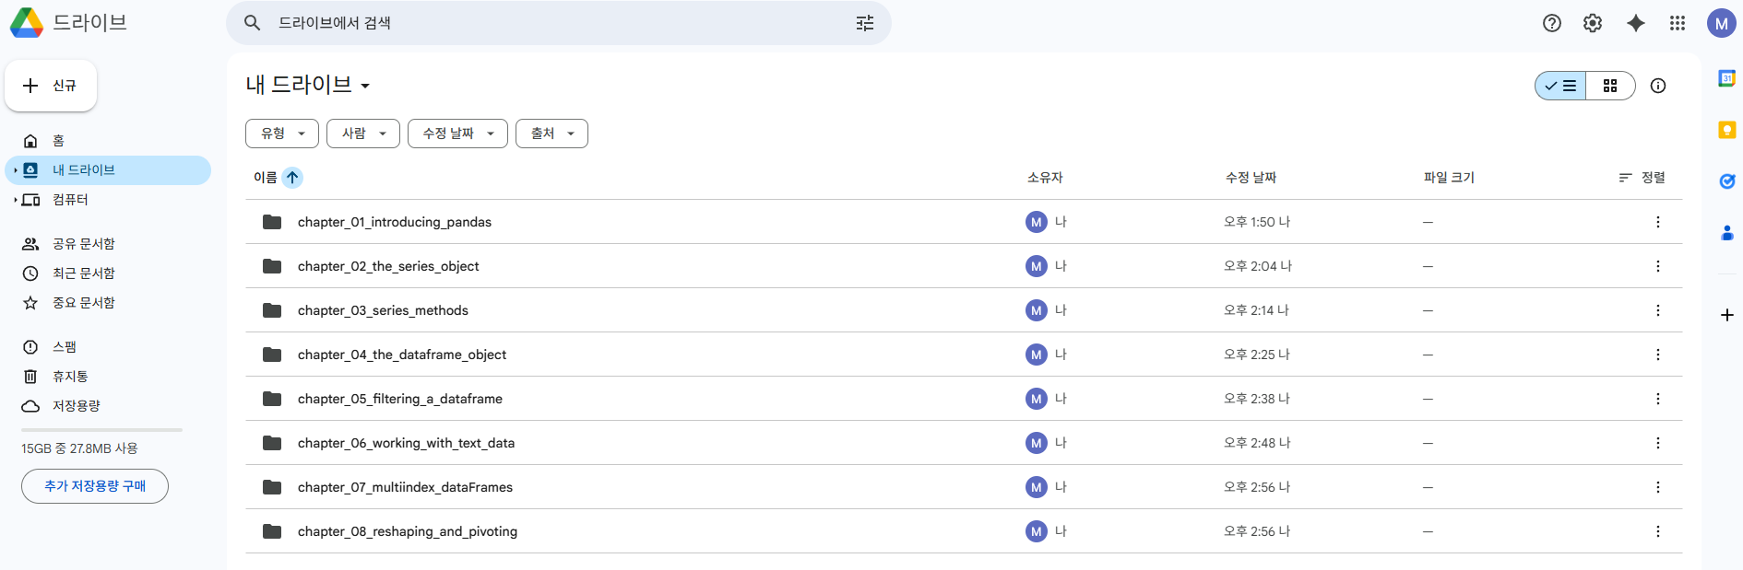
Working environment for coding
Google Colab (Colaboratory)
1) Make a new account of Gmail for coding as it will be done in public PC room.
2) Log in to Google drive with new Gmail ID.
3) Drag and drop of downloaded files (chapter 01~08) in My Drive as shown in below.

Slide 11
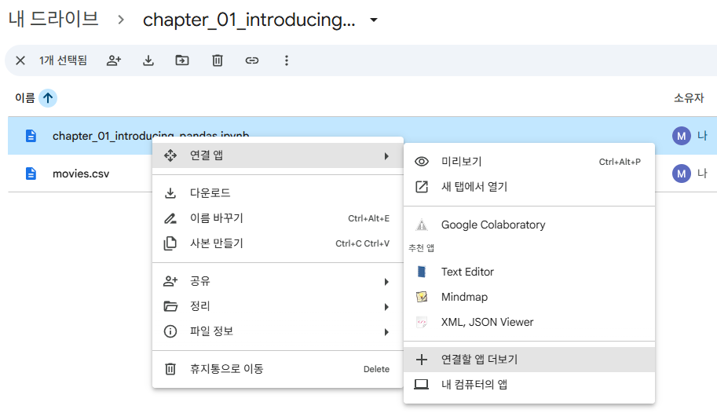
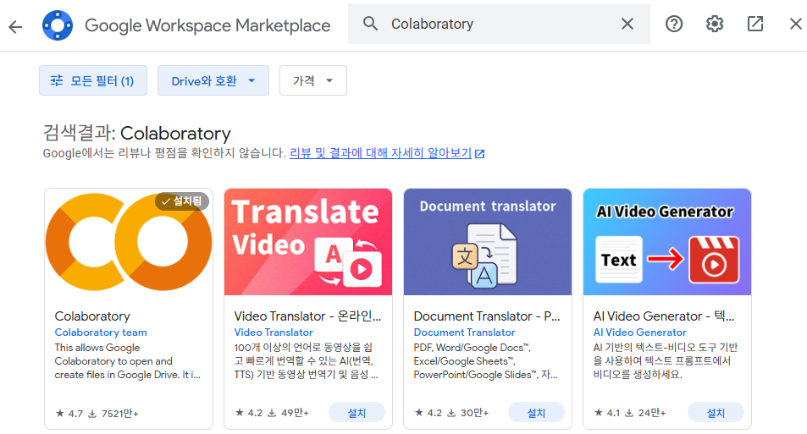
Working environment for coding
4) Click “연결할 앱 더보기” as shown in below.
5) Search “Colaboratory” and download it.

Slide 12
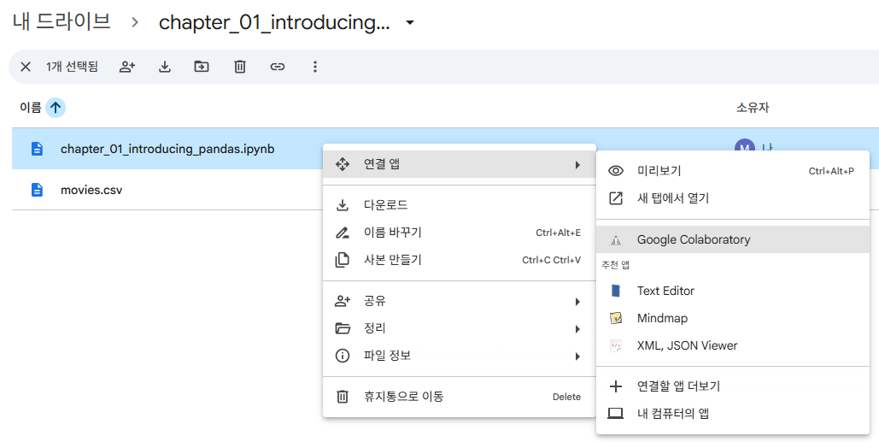
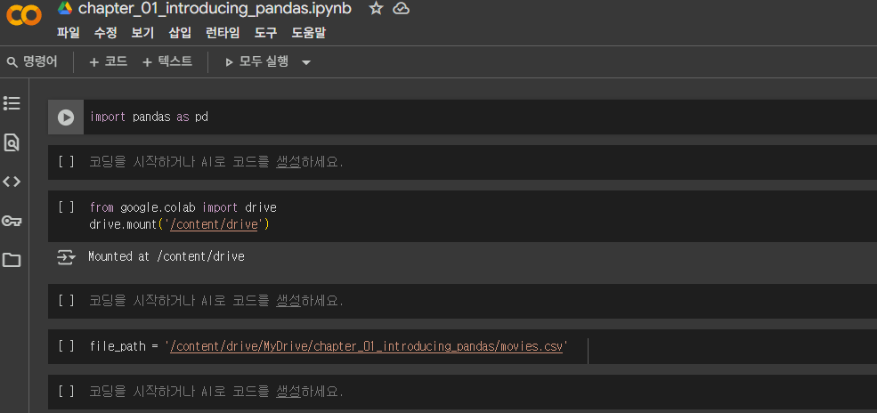
Working environment for coding
4) Click “Google Colaboratory” to open coding environment.
5) There are empty code boxes to practice coding.

